Slide 1
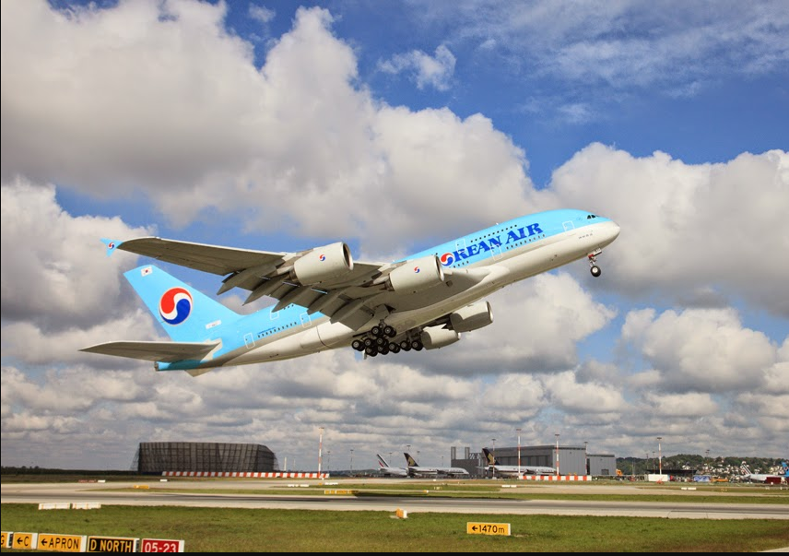
Presentation on
Flight Price Prediction
Presented By
Aamina Ruvaida

Slide 2
Agenda
Introduction
Problem Statement
Problem Understanding
Benefits of Flight Price Prediction
Exploratory Data Analysis
Data Visualization
Data Pre-processing
Model Building
Cross Validation Score
Hyper Parameter Tuning
Saving the Model
Model Prediction
Conclusion

Slide 3


Introduction
The airline industry encompasses a wide range of businesses, called airlines, which offer air transport services for paying customers or business partners. These air transport services are provided for both human travellers and cargo, and are most commonly offered via jets, although some airlines also use helicopters.
Airlines may offer scheduled and/or chartered services and the airline industry forms a key part of the wider travel industry, providing customers with the ability to purchase seats on flights and travel to different parts of the world. The airline industry offers a variety of career paths, including pilots, flight attendants and ground crew.
Airlines are often grouped into different categories and precise definitions can vary in different parts of the world.
International Airlines
National Airlines
Regional Airlines

Slide 4
PROBLEM STATEMENT
Anyone who has booked a flight ticket knows how unexpectedly the prices vary. The cheapest available ticket on a given flight gets more and less expensive over time. This usually happens as an attempt to maximize revenue based on -
1. Time of purchase patterns (making sure last-minute purchases are expensive)
2. Keeping the flight as full as they want it (raising prices on a flight which is filling up in order to reduce sales and hold back inventory for those expensive last-minute expensive purchases)
Business Goal:
The main aim of this project is to predict the flight price based on the analysis of various features. How flight price vary from distance, time it differ from usual flight price. We have to build a machine learning model to predict the flight price. This will help the buyer to decide whether to buy the ticket for flight or not. At which time flight price will reduce. So, that buyer can buy the ticket at the cheaper rate.

Slide 5


PROBLEM UNDERSTANDING
In today’s world of globalization, people travel from one country to another for the purpose of business or leisure. High competition in this field has prompted airlines across the world to introduce International flight deals to capture the large volume markets. Cheap flight deals give travellers an opportunity to travel to places that otherwise were not excisable due to the high airline ticket prices. The biggest question that haunts many customers is how do airline prices fluctuate and how can one take advantage of the flight price fluctuation. Flight price tracker is one of the best ways to track offers introduced by airlines.
Flight price fluctuation is based on market demand. The decision to travel to a destination depends on the ticket price of the airlines. The flight price fluctuation is determined by various factors such as demand and supply, season and so on, it is advised that the travellers swim against the tide to get good offers.

Slide 6
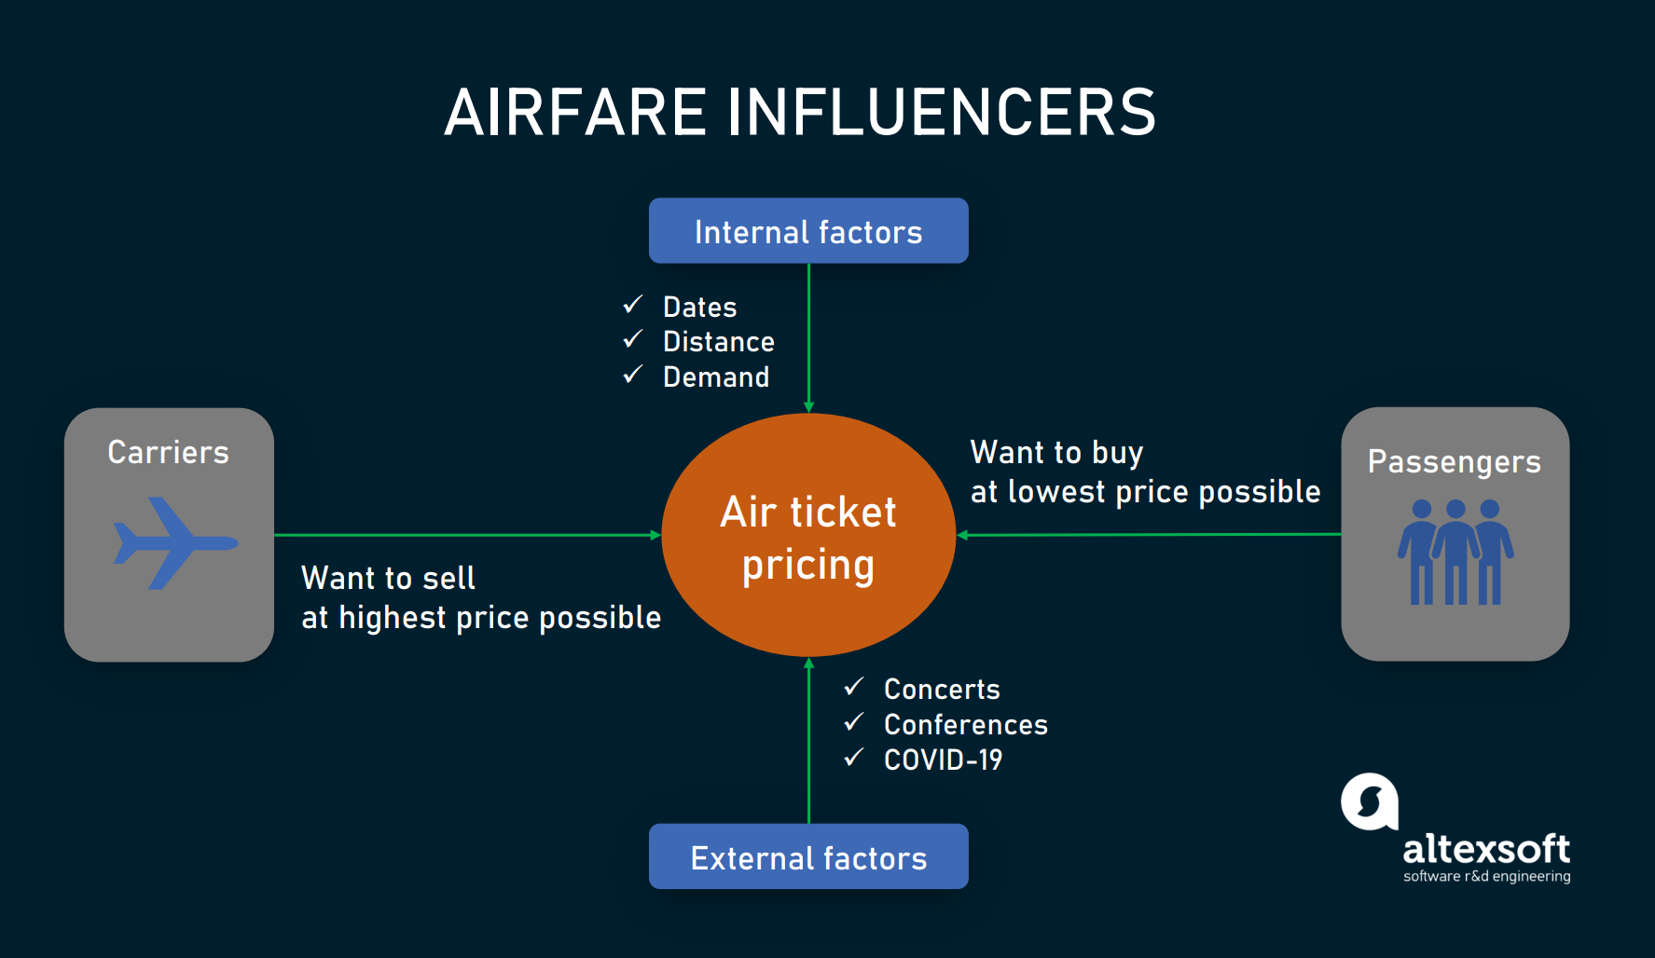

Slide 7

Benefits of Flight Price Prediction
Traveller get the fare prediction handy using which it’s easy to decide the airlines.
Saves time in searching / deciding for airlines.
User can login with valid credentials in order to access the web application. A traveller can access this module to get the future price prediction of individual airlines. The prediction will help a traveller to decide a specific airline as per his/her budget. Single entries of current or previous data can be made.
A passenger side predictor proposed by a OTA suggest the best time to buy a ticket so the traveller can make informed decision. Carriers on their end, try to find the optimal price they should set to maximize revenue while remaining competitive.
Flight price fluctuation is based on market demand. The decision to travel to a destination depends on the ticket price of the airlines. The flight price fluctuation is determined by various factors such as demand and supply, season and so on, it is advised that the travellers swim against the tide to get good offers.

Slide 8
Exploratory Data Analysis
Imported the necessary libraries and loaded the data set which we have scrapped the data from Yatra website.
Checked the shape, info, data types, statistical summary of data, count of value.
We have extracted the hour and minutes from Departure, Arrival and Duration. Make the datatype to datetime.
We checked the null value, there is no null value present in the data.
Our target value is price, we replace the string ‘,’ with empty space and make the data type as float.
We have checked any empty space present in data, there is no empty space.
Visualized the data using various plot. Box plot, distribution plot, scatterplot, stripplot, violinplot, lineplot to analysis the data.
Done the feature engineering, data preprocessing , data cleaning.
Checked the correlation of data and visualized it using heatmap.
Then we have separate the feature and target into x and y. Then we have build the machine learning model and make the flight price prediction.

Slide 9

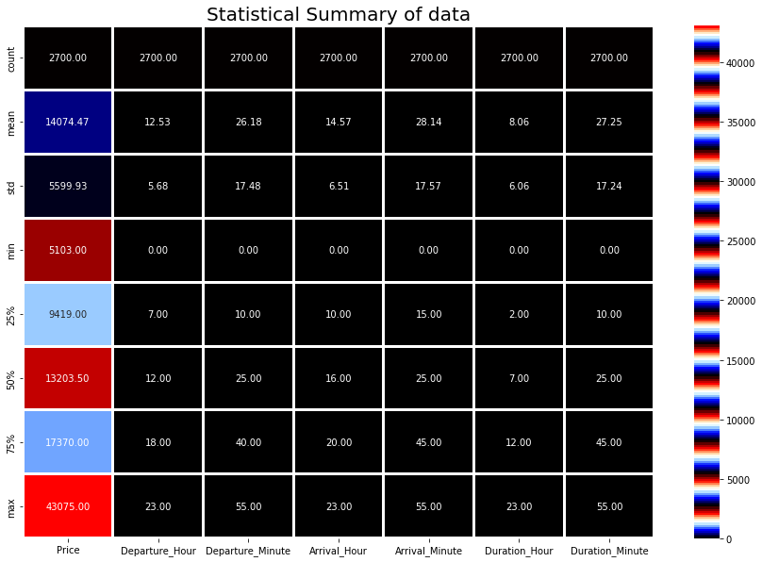
Statistical Summary of Data
In the statistical summary of data, we see the count 2700 in all columns that means there is no null value present.
We see the Mean, standard deviation, min, max value, median, 25th,75th Quartile of all features in the dataset.
We see that Mean is greater than median..

Slide 10

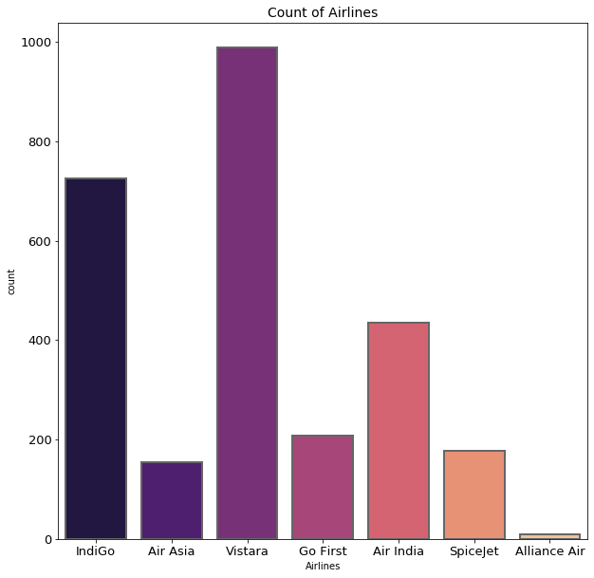
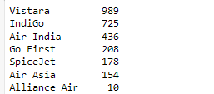
Visualization of Airline Count
We see that the highest count in Airline is Vistara 989, then comes IndiGo, Air India. Which means majority of people using this flight to travel.
The least count of Airline is Alliance Air, it has less count 10. People are not likely to prefer this flight to travel.

Slide 11
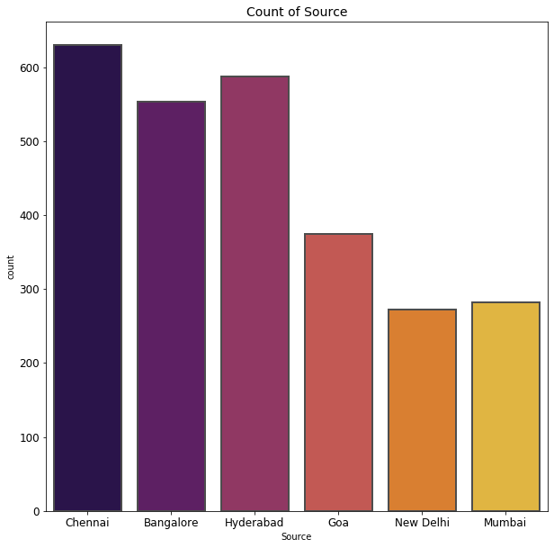
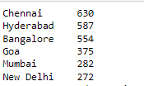
Visualization of Source Count
The highest count of source location is Chennai which is 630. Then comes Hyderabad, Bangalore. Majority of people travelling from this country.
The least count is New Delhi. Less people travelling from Delhi.

Slide 12
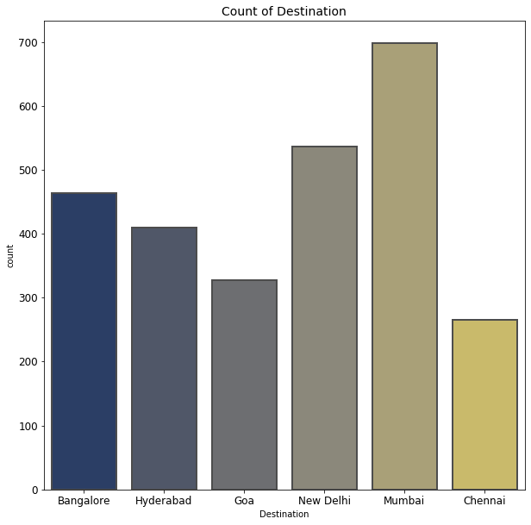
Visualization of Destination Count
We see that majority of People destination location is Mumbai, then next to Mumbai mostly visit place is New Delhi, then Bangalore.
Least visited destination place is Chennai.

Slide 13

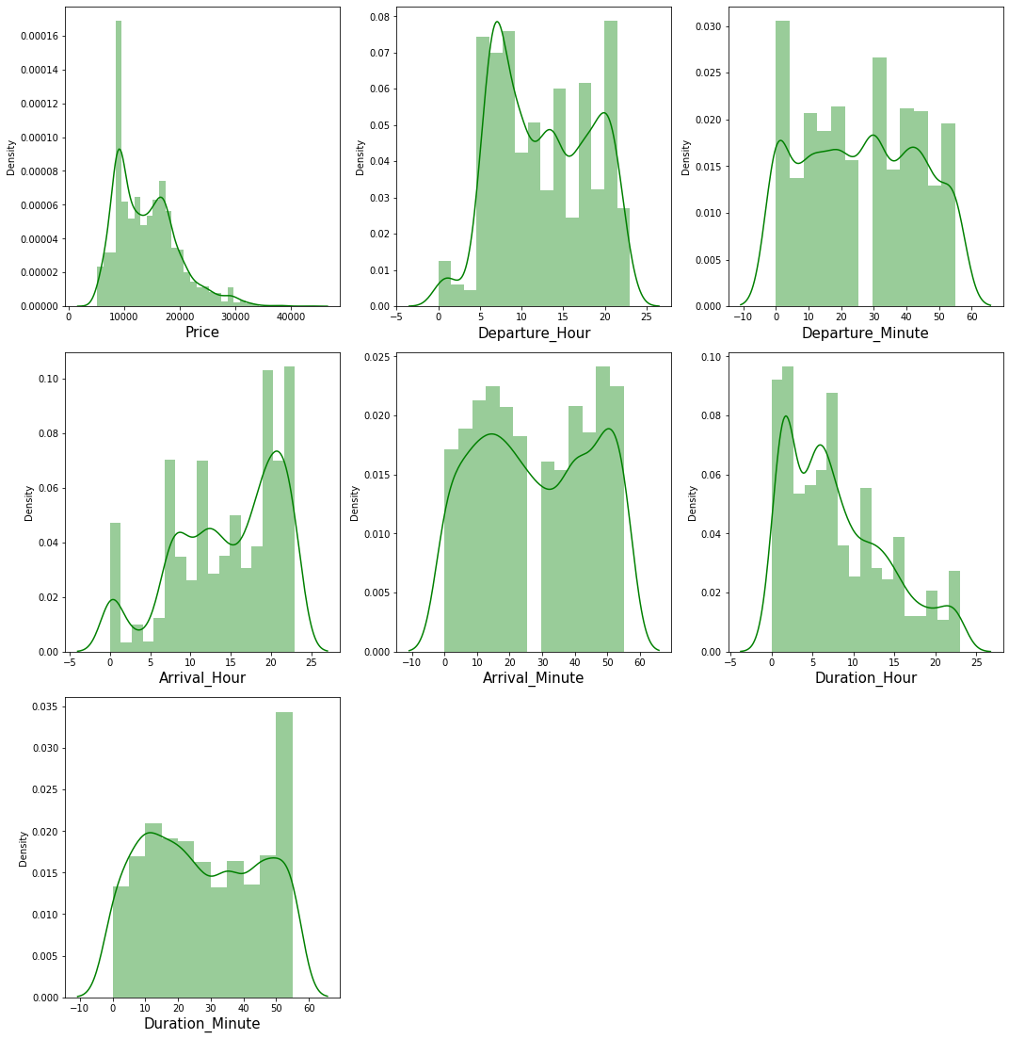
Visualization of Distribution plot for Numerical value
The distribution plot shows how the data is distributed.
We see that most of the column is normally distribution but don’t have proper bell shape.
Price, Duration Hour, Duration minute are skewed to the right side, Mean value is greater than median.
Arrival Hour, Arrival minute, Departure hour, Departure minute are skewed to the left side. Mean value is less than median.
There is skewness present in data. We need to remove the skewness using the yeo-johnson method using the pre-processing technique.

Slide 14

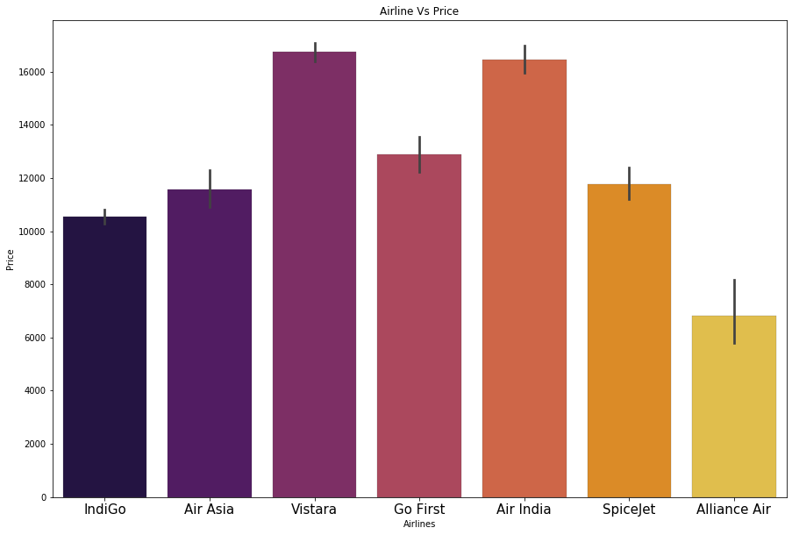
Comparing the Airlines with Price
From the barplot we see the all Airline with Price.
Vistara and Air India have high price as compare to other. It also affect based on other factors. Like Time, Place, Demands.

Slide 15
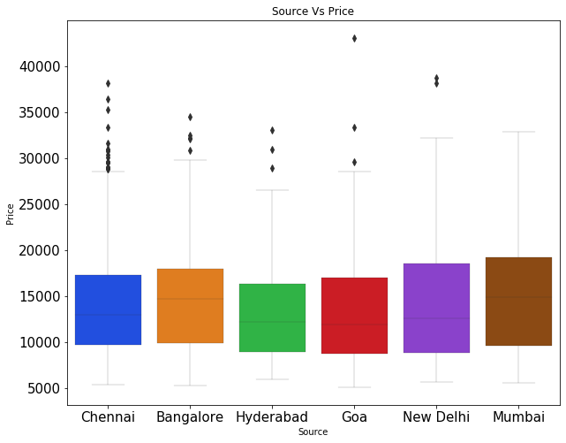
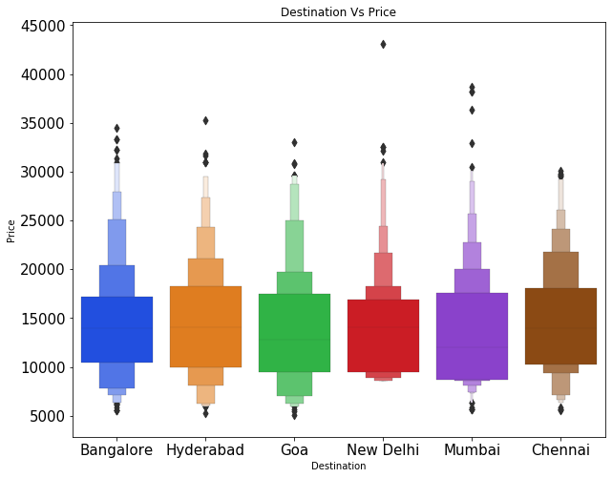
Visualization of Source and Destination
From the above chart we see the source and destination location with Price. In source Chennai have the high price, In Destination Mumbai have the high price.

Slide 16
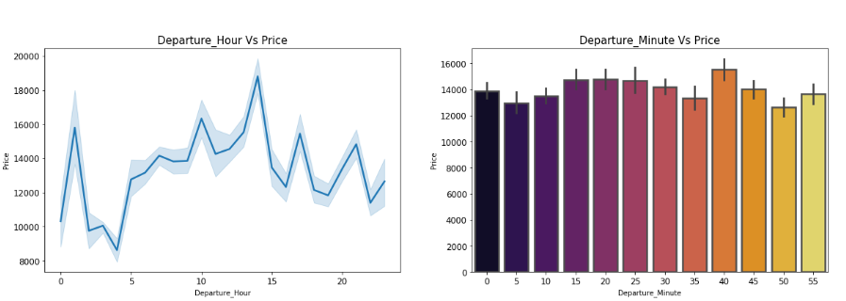
Visualization of Departure Time
In the Departure Hour the price is high at 14hrs and Departure Minute the price is high at 40 minutes.
We see that price is fluctuating up and down. In the early morning 0 to 6 AM the flight price is less, In Afternoon, Evening the prices goes increasing.

Slide 17
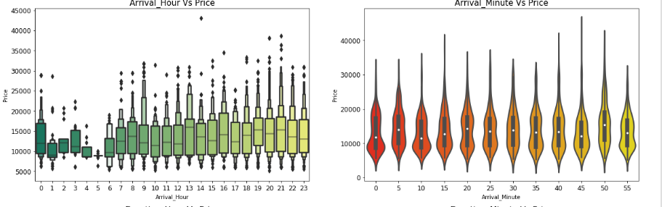
Visualization of Arrival Time
In Arrival Hour the price is high after the 7AM. In the early morning 0-6 AM the flight price is low. In the afternoon and evening the flight price is high based on the other features involved.

Slide 18
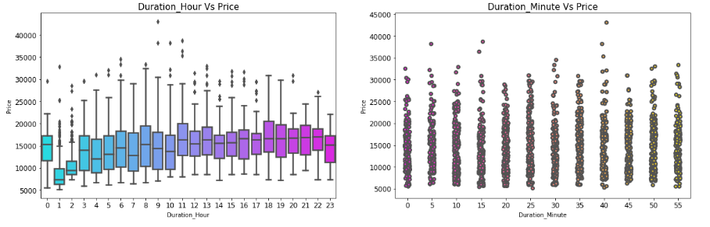
Visualization of Duration Time
As the Duration of time increases the price also increasing drastically.

Slide 19

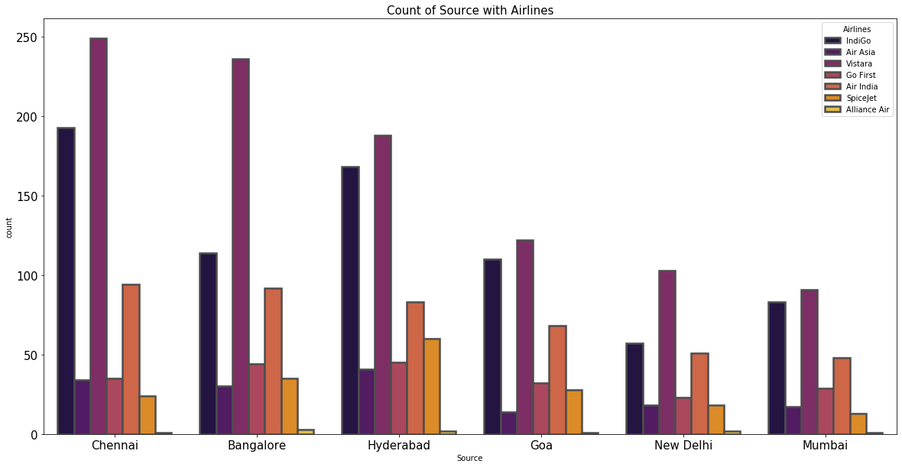
Visualization of Source, Airline with Price
Vistara airline count is high, majority of people is travelling from Chennai. The least source location is Mumbai, very less people source location is Mumbai.

Slide 20
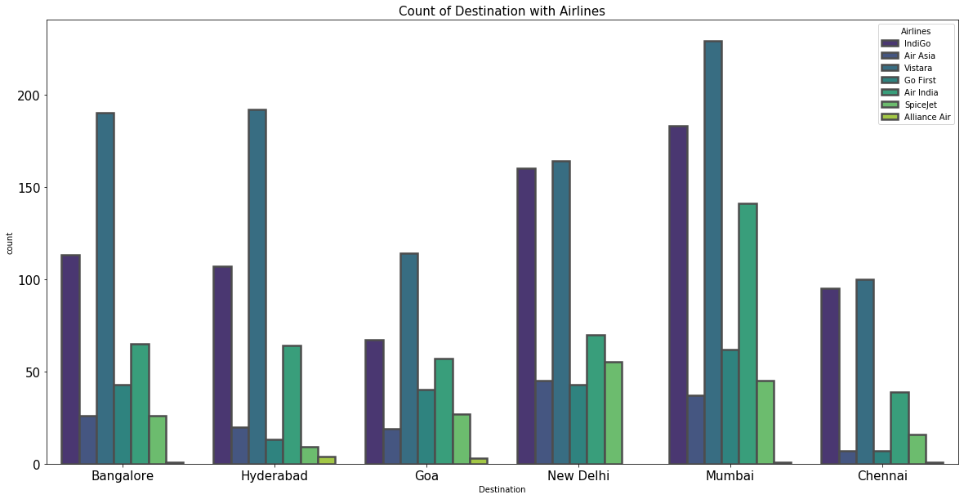
Visualization of Destination, Airline with Price
Vistara airline count is high as usual, majority of people Destination location is Mumbai. The least Destination location is Chennai.

Slide 21
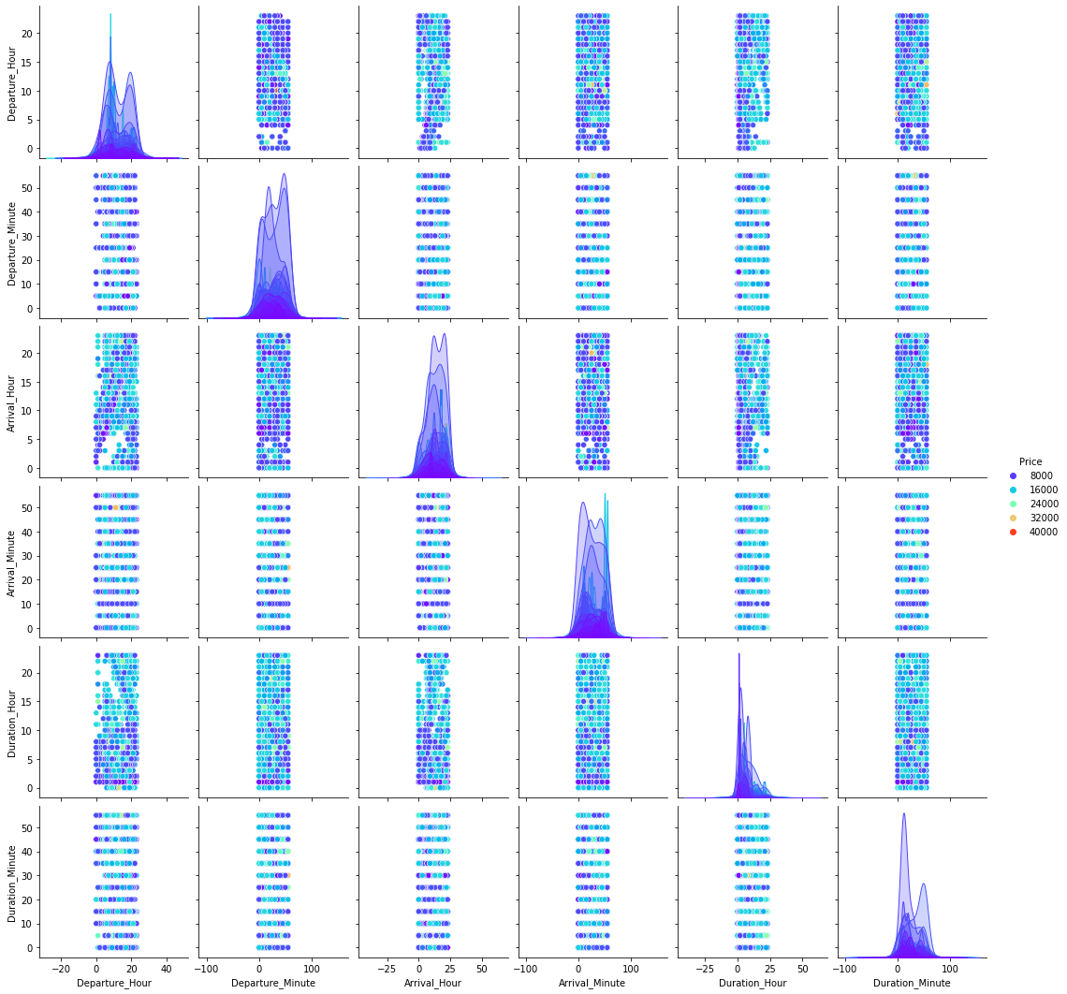
Visualization of Pair plot of all features

Slide 22
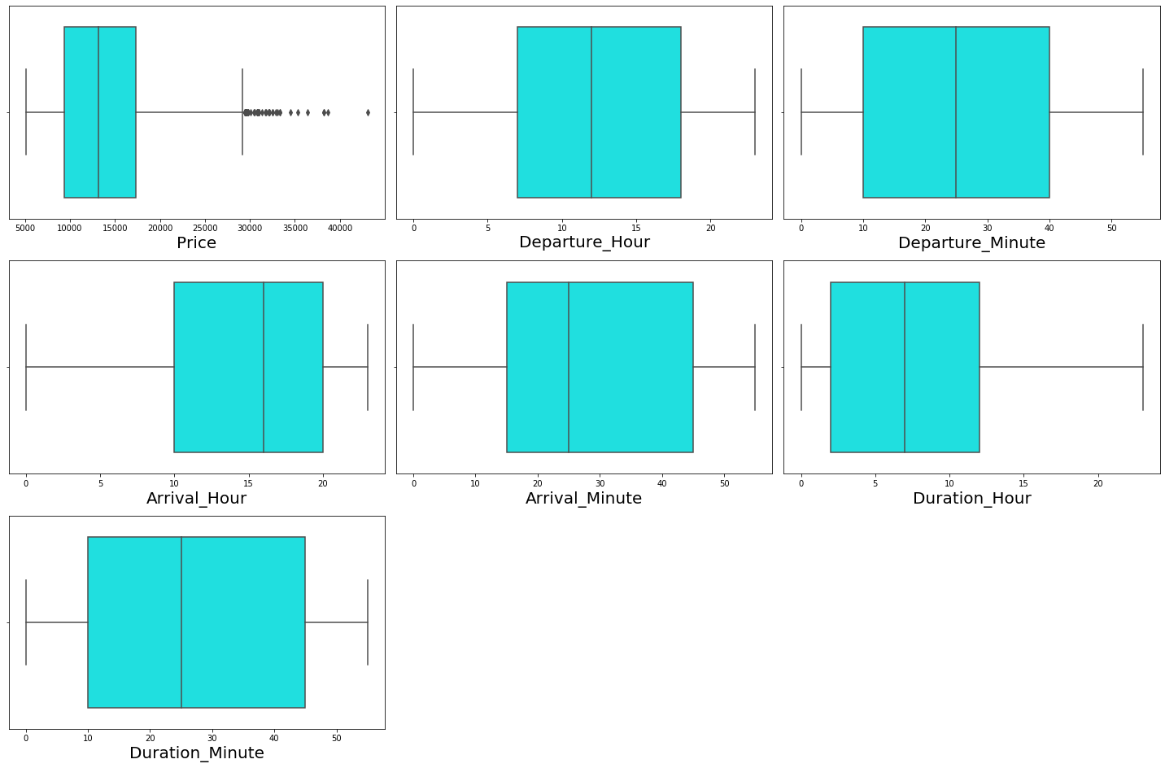
Outliers
From the Above boxplot, we see that Outliers are present in Price. Hence it is our target variable. So no need to remove outliers in Price.

Slide 23

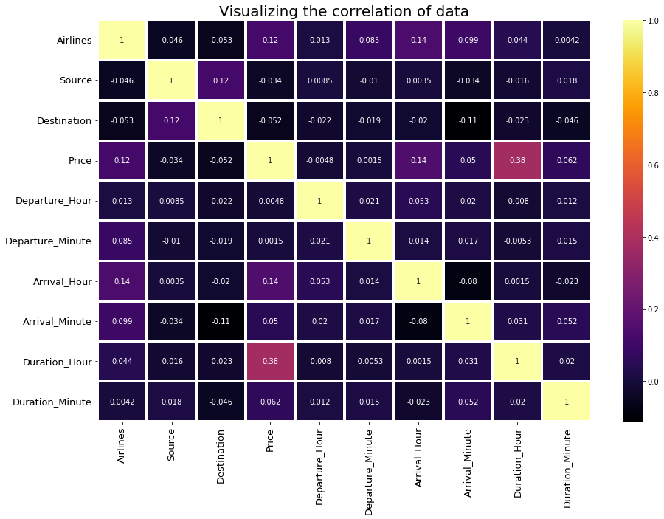

Slide 24
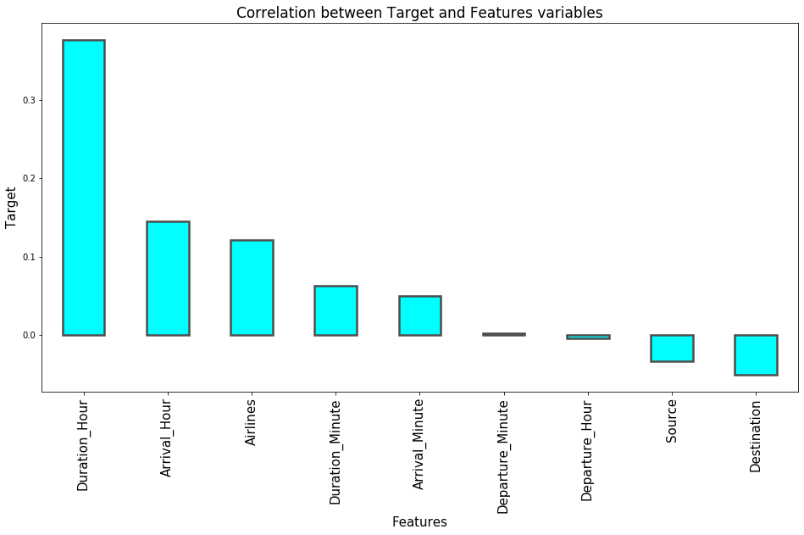
Departure Hour and Departure Minute is less correlated, Duration Hour is positive and highly correlated, Destination and Source is negatively correlated.

Slide 25

Data Analysis Steps
Done the Feature engineering and extracted the hour and minute from Departure, Arrival and Duration to improve the data and linearity.
Identified the Outliers and Skewness. Removed the skewness using the Power Transformer yeo-johnson method.
Checked the correlation of data for Independent and Dependent Variables.
Standardized the data using the Standard Scaler.
Split the data into x and y variable for training and testing the data.
Build the machine learning model and done the cross validation score. Performed the Hyper parameter tuning. Finalized the model and saved in Pickle.
Predicted the flight price. Compare the actual price and predicted price of flight.

Slide 26
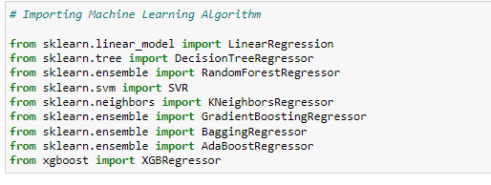
Model Building
In this project Price is our target variable. It is a continuous variables. So it is a Regression Problem. We use the Regression Machine Learning algorithm to make the prediction.
After cleaning the data, Feature Engineering, Data Pre-processing. Data is good to proceed the model building and further analysis. We use the below Machine Learning Algorithm in our project.
Linear Regression
Random Forest Regressor
Decision Tree Regressor
Bagging Regressor
Extreme Gradient Boosting Regressor
Ada Boost Regressor
Gradient Boosting Regressor
KNeighbors Regressor.
We have got the best random state and r2 score. We used the evaluation metrics in the project.

Slide 27
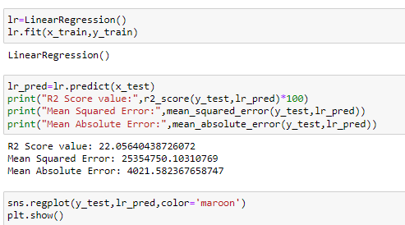
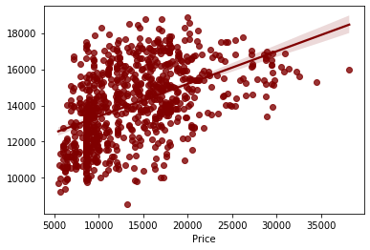
Linear Regression
Build the Linear Regression Model and checked the evaluation metrics. We got the r2 score as 22%. It didn’t give the high accuracy. We will check the other models to check the accuracy.
In the Regression plot, the straight line is our actual data and dot denoted the predicted data. We see that how actual and predicted values are spread.

Slide 28
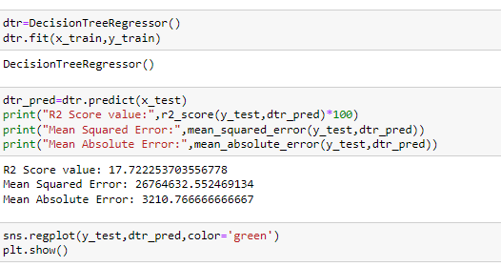
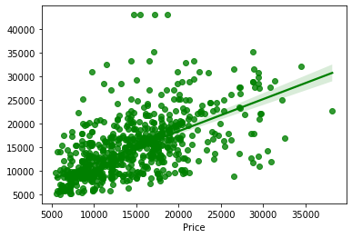
Decision Tree Regressor
Build the Decision Tree Regressor Model and checked the evaluation metrics. We got the r2 score as 17%. It didn’t give the high accuracy. We will check the other models to check the accuracy.
In the Regression plot, the straight line is our actual data and dot denoted the predicted data. We see that how actual and predicted values are spread.

Slide 29
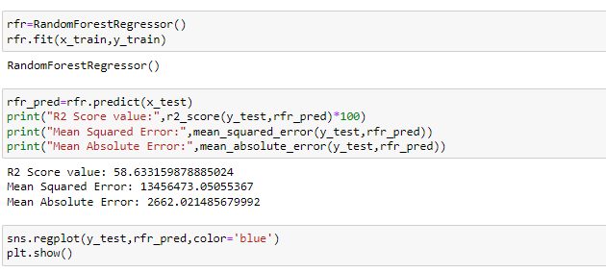
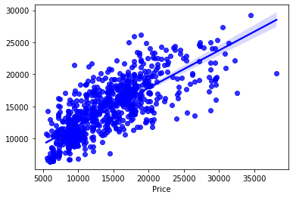
Random Forest Regressor
Build the Random Forest Regressor Model and checked the evaluation metrics. We got the r2 score as 58%.
In the Regression plot, the straight line is our actual data and dot denoted the predicted data. We see that how actual and predicted values are spread.

Slide 30
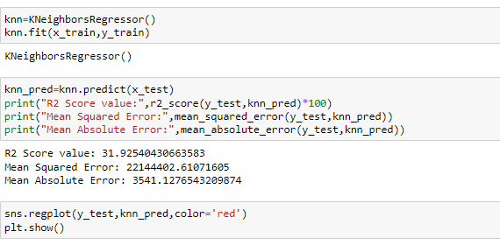
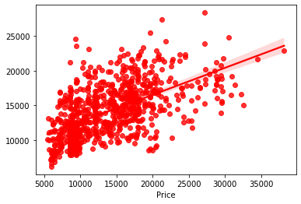
KNeighbors Regressor
Build the Kneigbors Regressor Model and checked the evaluation metrics. We got the r2 score as 31%.
In the Regression plot, the straight line is our actual data and dot denoted the predicted data. We see that how actual and predicted values are spread.

Slide 31
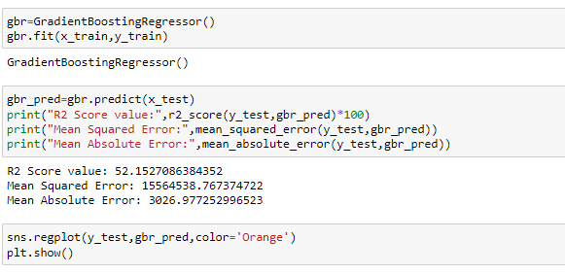
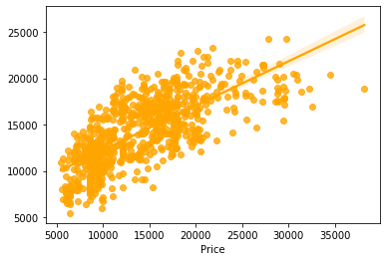
Gradient Boosting Regressor
Build the Gradient Boosting Regressor Model and checked the evaluation metrics. We got the r2 score as 52%.
In the Regression plot, the straight line is our actual data and dot denoted the predicted data. We see that how actual and predicted values are spread.

Slide 32
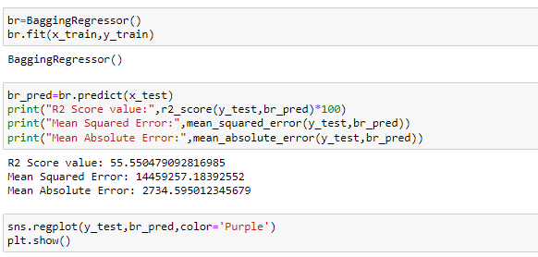
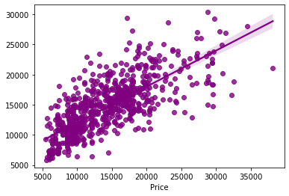
Bagging Regressor
Build the Bagging Regressor Model and checked the evaluation metrics. We got the r2 score as 55%.
In the Regression plot, the straight line is our actual data and dot denoted the predicted data. We see that how actual and predicted values are spread.

Slide 33
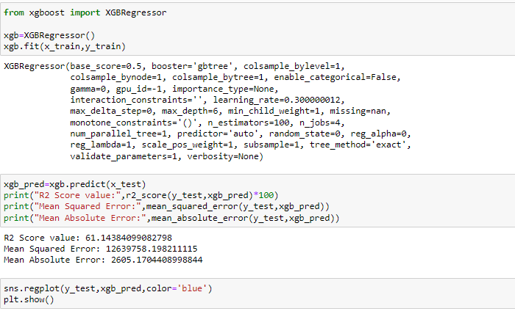
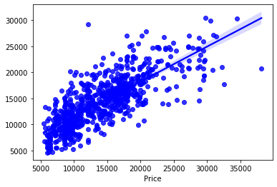
Extreme Gradient Boosting Regressor
Build the Extreme Gradient Boosting Regressor Model and checked the evaluation metrics. We got the r2 score as 61%.
In the Regression plot, the straight line is our actual data and dot denoted the predicted data. We see that how actual and predicted values are spread.

Slide 34
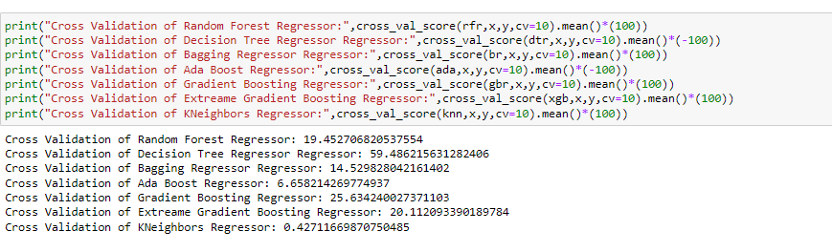
Cross Validation Score
We have checked the cross validation score of various machine learning model. Based on the analysis, we got the Extreme Gradient Boosting Regressor model as our final model. As it gives a good accuracy as compare to other models.

Slide 35
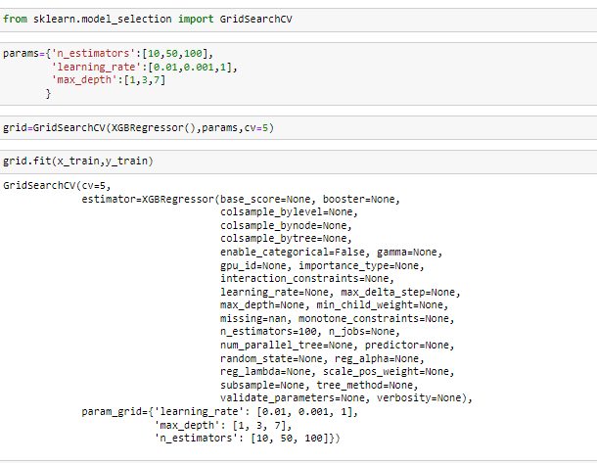
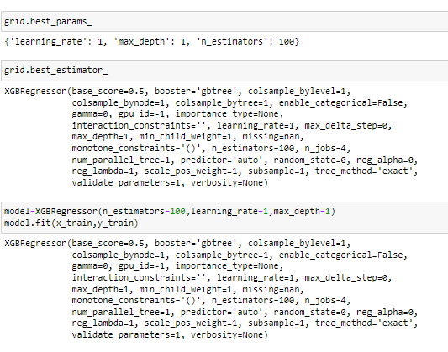
Hyper Parameter Tuning
I have done the hyper parameter tuning for our final model. It didn’t increase the accuracy. Checked the best parameter, score, Estimators.

Slide 36
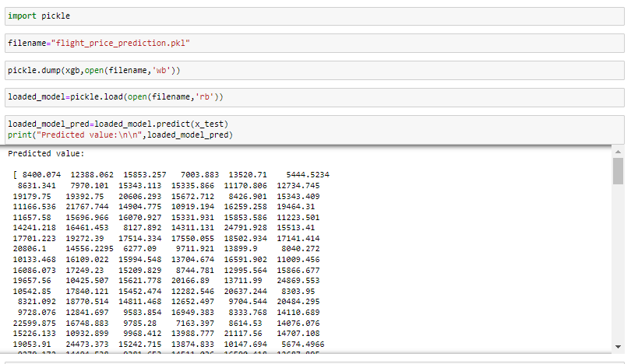
Saving the Model
We have finally saved the model for future use using the Pickle and predicted the value.

Slide 37

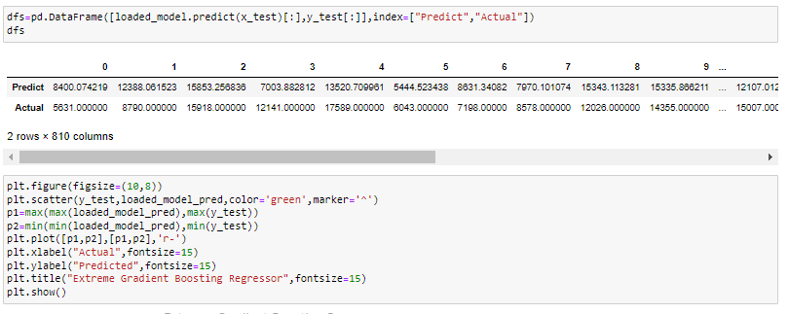
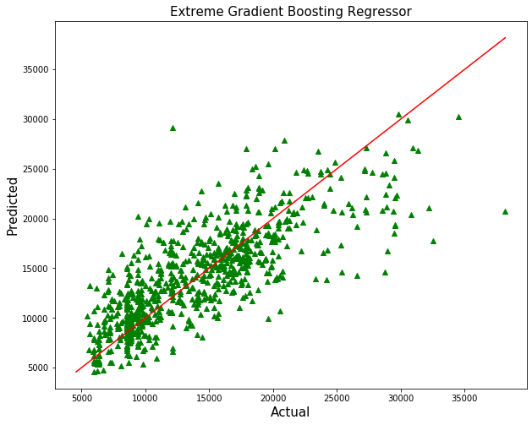
Prediction
Using the Regression Model, we predicted the Price based on the analysis of various features and using the Machine Learning model. In the above chart we see the straight line is actual value and triangle shape is the predicted value.

Slide 38
Conclusion
The main aim of the flight price case study is to used Machine Learning Algorithm and predict the price of Flight based on features available in dataset.
First I have collect the data from yatra.com website using the web scraping tool selenium and fetch all the features and price of flight.
Then I have done the data cleaning, data pre-processing, Data Visualization. Checked the Outliers, Skewness. Removed the skewness using Power Transformer method.
Used various machine learning algorithm and predicted the flight price.
This will help the buyer to decide at what time the flight price is less, which airline gives a moderate flight price, which airline take maximum time to reach the destination. Based on the analysis one can decide whether to buy the flight ticket or not.

Slide 39
Thank you

